Slide 1





Bringing visibility to food security data results: an experiment in Research Data Alliance (RDA) PID tools
Quan (Gabriel) Zhou, Inna Kouper and Beth Plale
Indiana University
Jason Haga
AIST, Japan
Venice Juanillas and Ramil Mauleon
International Rice Research Institute
National Data Service Workshop, Oct 2016

Slide 2
Motivation
Experiment with recent Recommendations emerging from Research Data Alliance (RDA) around persistent identifiers (PIDs)
Apply to real use case, rice genomics analysis
Design solution in modular way so that RDA tools can be used by multiple groups
Carry out simple evaluation that compares RDA tools running at AIST in Japan versus running at NDS in Urbana Champaign Illinois
Harden service for rice genomics community while at same time using experiment as input to RDA working group on minimal metadata for PIDs
Page 1

Slide 3

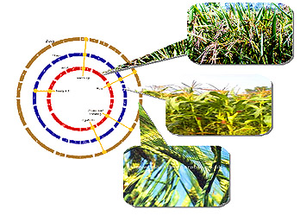


Rice genome variant discovery
PRAGMA compute VMs:
Rocks VM for Galaxy workflow
Persistent ID Types (PIT) Recommendation: conceptual model for structuring typed information, an application programming interface for access to typed information and demonstrator implementing the interface
Data Type Registry (DTR) Recommendation: aid data sharing efforts through improved data typing, specifically through a federated registry for registering data types.
PRAGMA Data Services:
Model for extracting provenance from Rocks VMs and client tool;
MongoDB data store for published data;
DataIdentity service for publishing data objects with PIDs and creating landing pages
Six modular pieces to archi-tecture
2
4
1
5
6
3

Slide 4
Application Motivation
Int’l Rice Research Institute (IRRI), Manila Phillippines, has a community of researchers carrying out genome wide association studies (GWAS) of their own phenotyping data
IRRI has 3000 rice genomes and a common analysis framework
IRRI is willing to provide analysis framework for free, but wants researchers to share results back
Is interested in reproducibility of results as well
Page 3

Slide 5
Typical Workflow Scenarios
Inside Galaxy Workflow
Input dataset (phenotype)
Upload phenotype data
Built-in genotype dataset (3K RG core SNPs)
Select phenotype data to merge;
Merge phenotype to genotype data
Pre-computed kinship matrix
GWAS GLM (parameters specified)
GWAS MLM (parameters specified)
GWAS GLM Results
GWAS MLM Results
Page 4

Slide 6


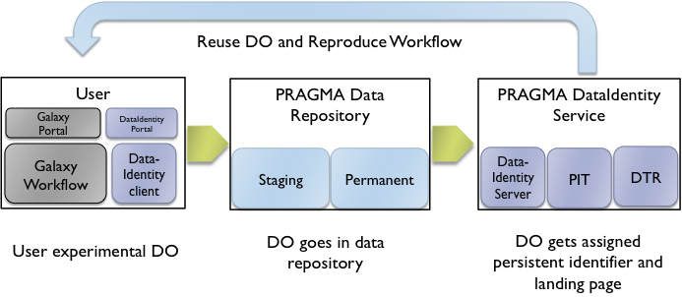
Our overall solution
1. End-user
2. Repository Service
3. PID Service
Reuse DO and Reproduce Workflow
IRRI Galaxy VM
PRAGMA Data
Repository
DataIdentity Service
Galaxy
Portal
DataIdentity
Portal
MongoDB
Data-Identity
Server
RDA PIT
RDA DTR
Galaxy Workflow
Data- Identity
client
User experimental DO
DO to
repository database
DO assigned persistent identifier and landing page
Page 5

Slide 7


Demo – Reproducibility in Rice Genomics Workflow
Page 6

Slide 8
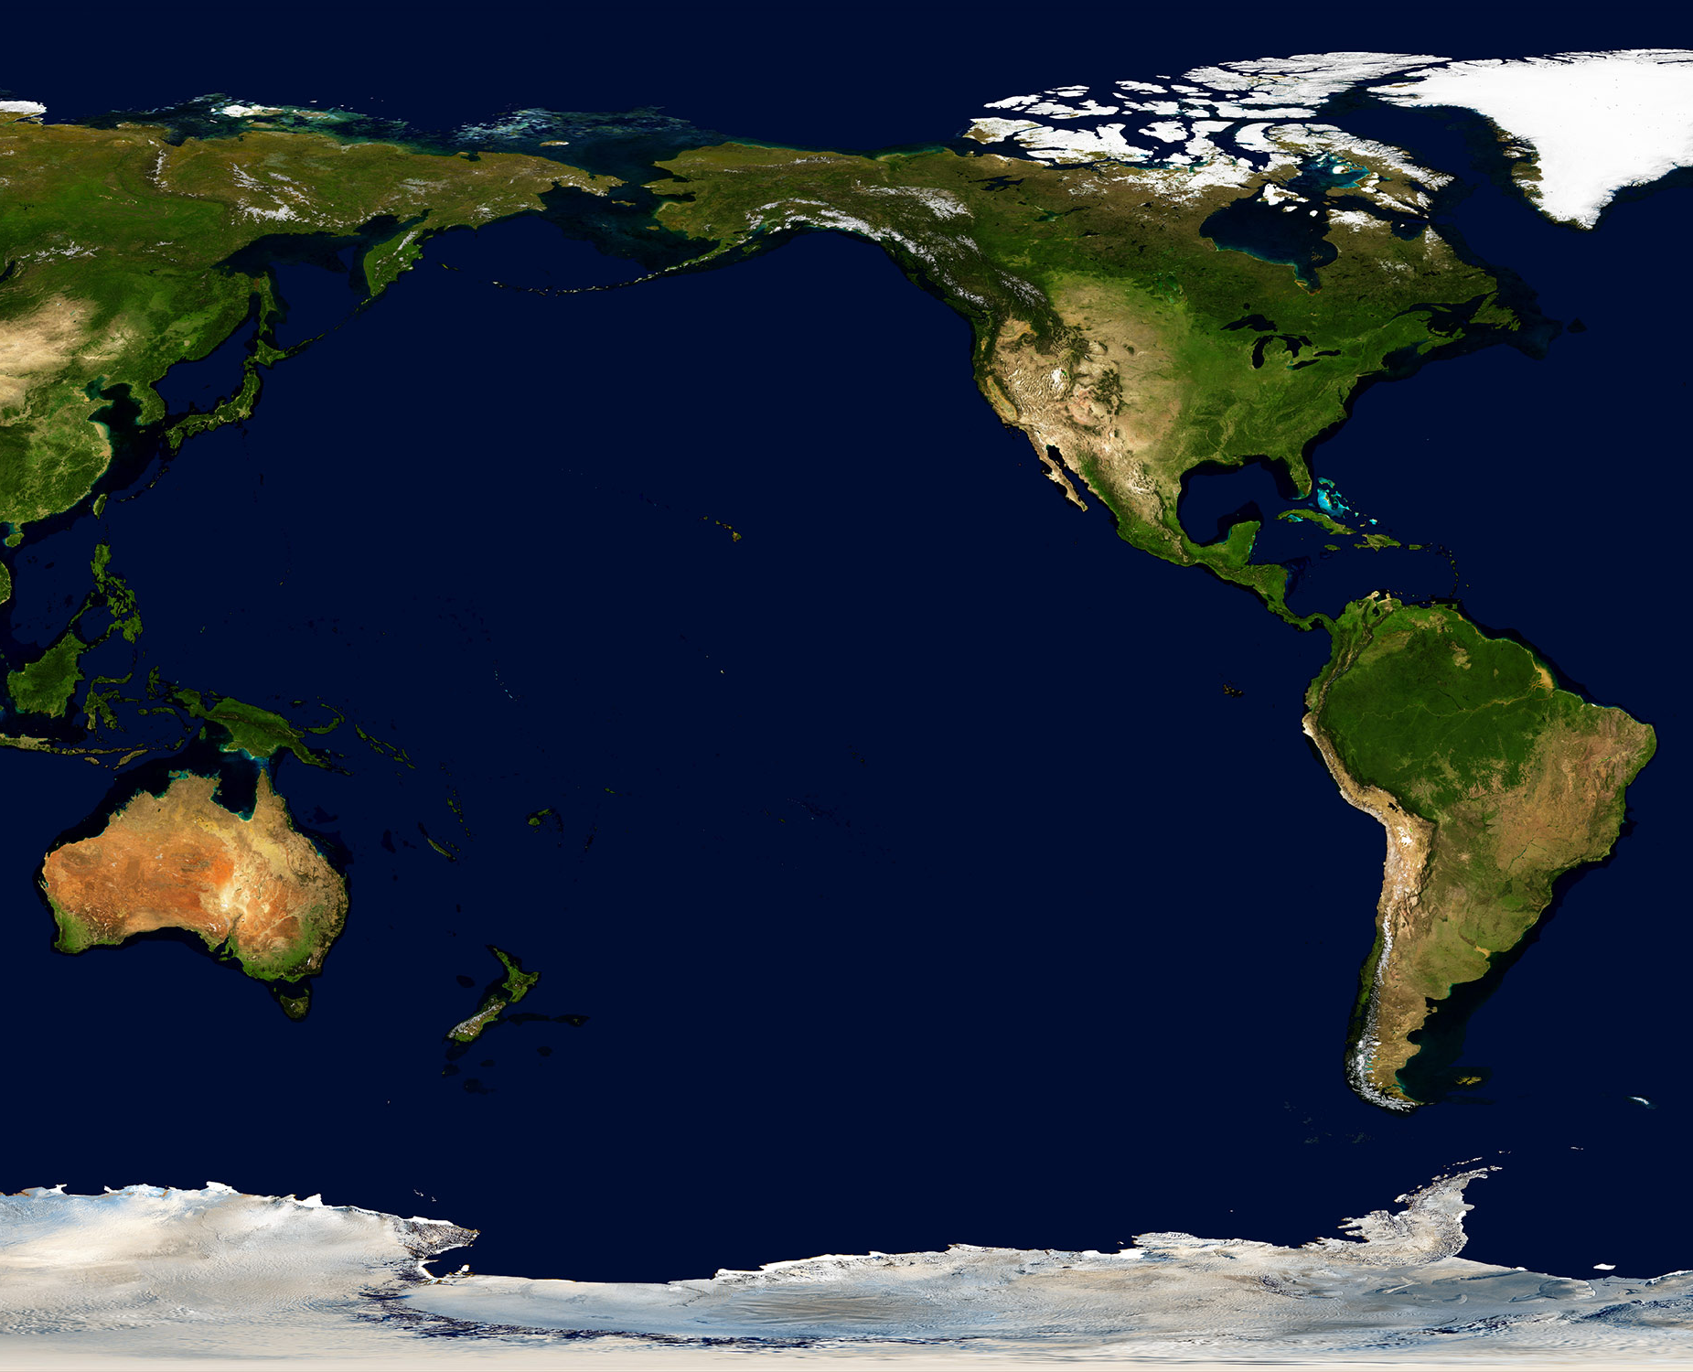

Deployment Diagram
PRAGMA Data Identity Service
PRAGMA Data Repository
NDS, IL
CNRI, VA
AIST, Japan
SDSC,CA
PRAGMA Data Identity Service
Handle.net Service
Data Identity GUI
Galaxy
Server
Service Route 1
Service Route 2
Page 7

Slide 9
Philosophy behind RDA PIT and DTR
PID systems (DOI, Handle, ARK) all support small amount of metadata (minimal metadata) associated with each PID
RDA PIT and Data Type Registry (DTR) Recommendations use Handle system
on philosophy that DOI minimal metadata too citation centric
RDA DTR holds type/profile definitions of minimal metadata
Under RDA model, every attribute and value in <attribute, value> pair is typed, given a Handle and stored to the DTR
A minimal metadata definition, an aggregate of attributes, is called a profile. It too resides in the DTR
Page 8

Slide 10
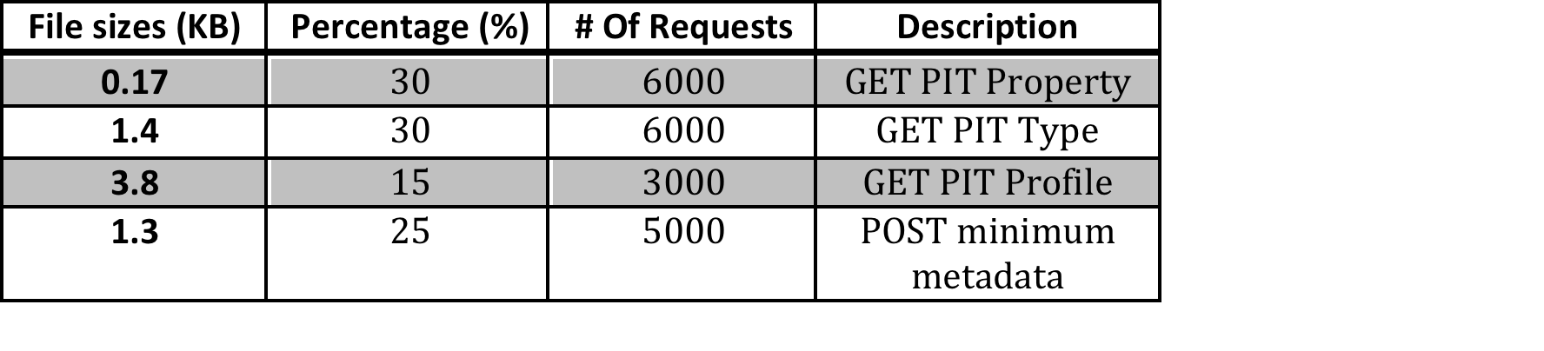
RDA PIT/DTR Service Benchmark
Our benchmark metrics are as follows
Throughput as requests per second
Response time as elapsed time from request send to receipt at client
Service response time/throughput over time: capture jitter of international networks
Benchmark test workload consists of mix of GET/POST on attributes of different granularity of Data Type Registry
Page 9

Slide 11
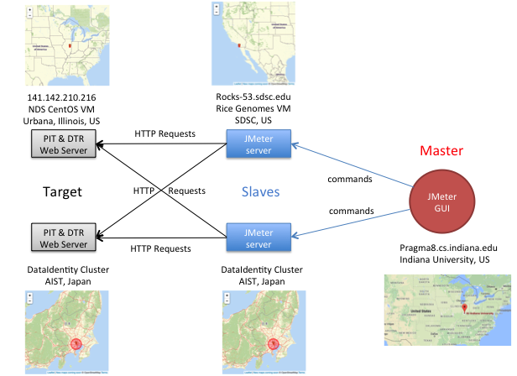
Test framework
Page 10

Slide 12
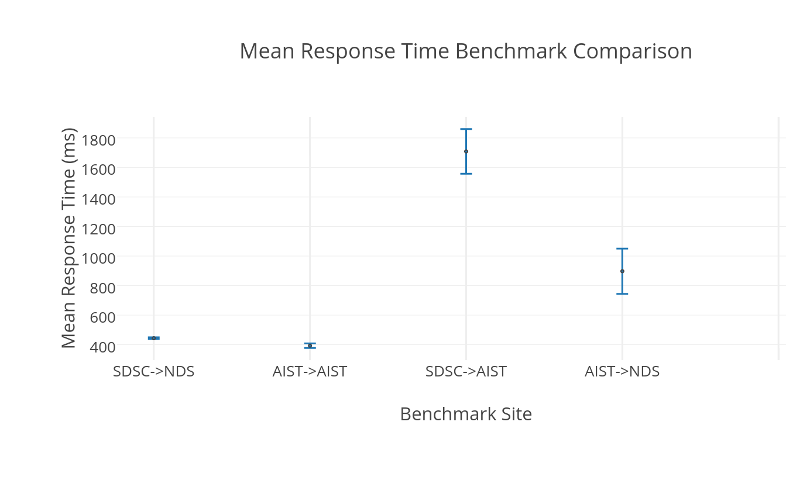
Response time: SDSC/AIST as Initiator
Page 11

Slide 13
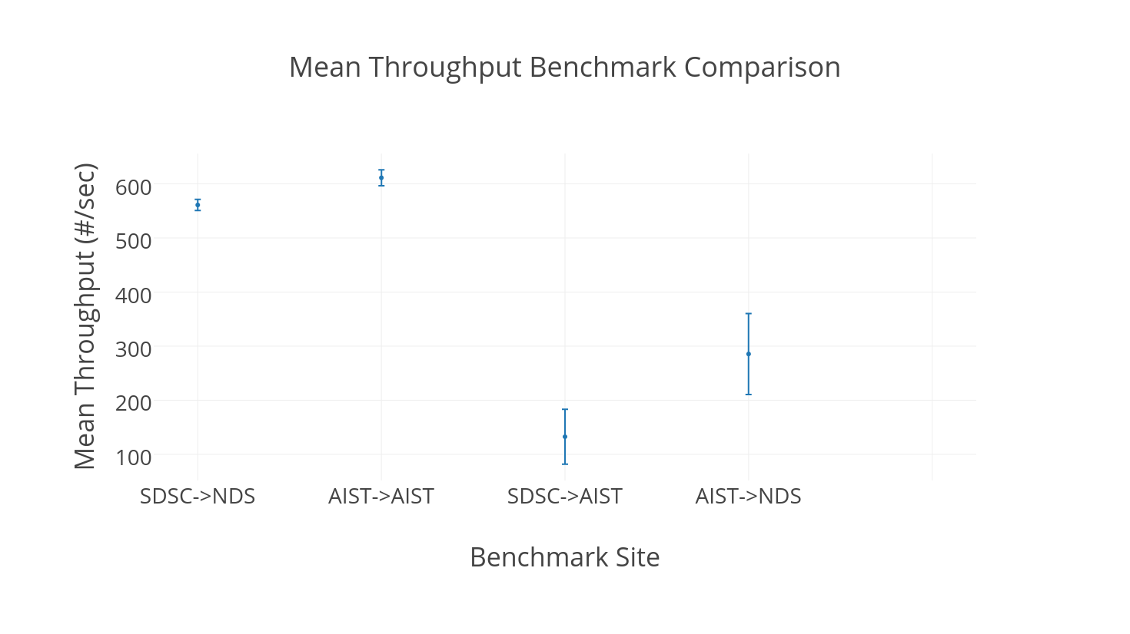
Throughput: SDSC/AIST as initiator
Page 12

Slide 14
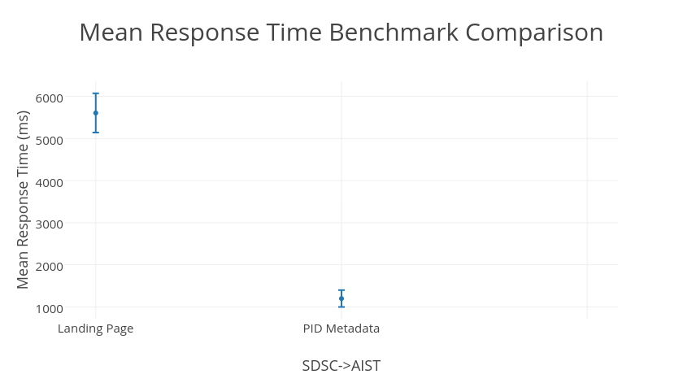
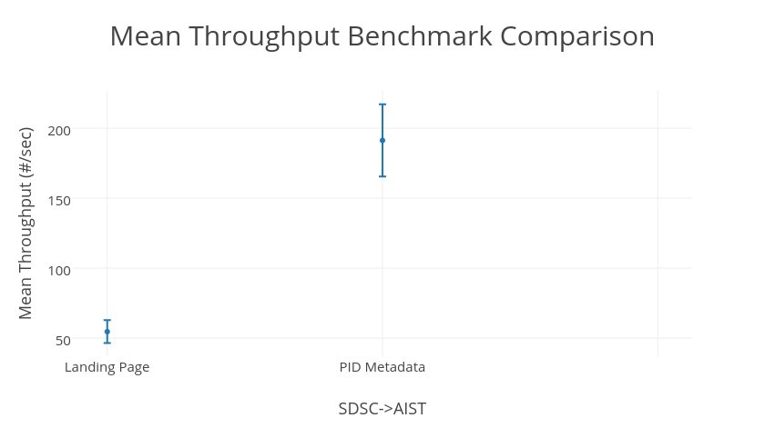
SDSC->AIST: PID metadata VS Landing page
Page 13

Slide 15

Success to Date
The PRAGMA Data Services is a user transparent means of harvesting DOs from applications and assignment of PIDs to scientific outcomes
Modular architecture, informed by core members of the rice genomics team
Software is stable.
Built with default PIT Profile (RDA inside!)
High-impact, multi-disciplinary effort in the Pacific Rim
Cross WG interactions in RDA (Rice Data Interoperability)
Page 14

Slide 16
Next Steps
Harden PID services for IRRI rice genomics community
User study
User interface improvements
Define and convey to users policy issues on sharing results
Release anticipated early 2017
Growing US Engagement in PID use through RDA and NDS
Lead effort (Beth Plale, Tobias Wiegel) in RDA to define minimal metadata for PIDs
Currently in RDA Data Fabric IG; in process of forming working group
Page 15

Slide 17
Why important? PIDs for all sorts of uses, not necessarily just tied to publishing of datasets associated with publications

Slide 18

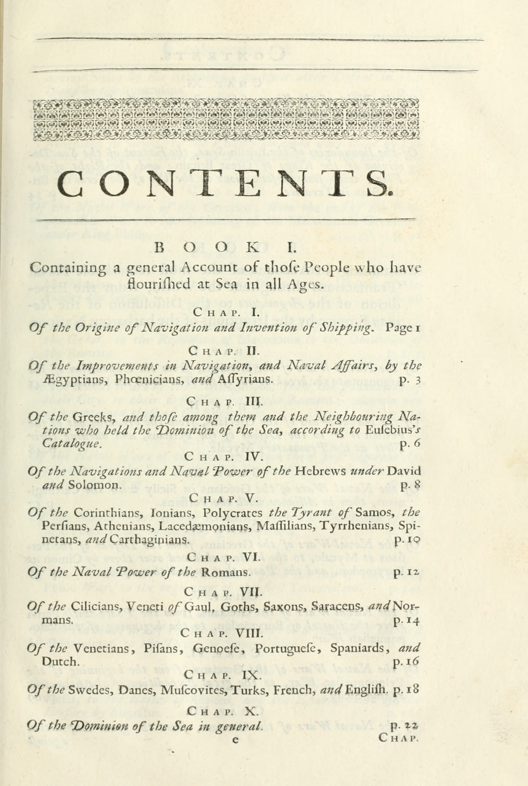

Imagine a world where PIDs identify just about everything: - Internet of Things - Movie clips - Pages from digitized books - Baby food containers Imagine an Internet (software) client that is handed a list of a billion IDs. How will the client quickly go through the list to find, say, the entities that are research data?
Page 17

Slide 19
Join Us!
RDA PID Profiles Subgroups Contact:
Beth Plale, plale@indiana.edu; Gabriel Zhou, quzhou@indiana.edu;
Tobias Weigel, weigel@dkrz.de
Data Provider Subgroup – Digital Humanities
1. Bridget Almas, Tufts
2. Ulrich Schwarzmann, GWDG, Germany
3. Beth Plale, Indiana University
Data Provider Subgroup – Natural/Physical Science
1. Stuart Chalk, Univ North Florida
2. Alex Thompson, iDigBio
3. Yunqiang Zhu, Institute for Geographic Sciences and Natural Resources, CAS, China
4. Cyndy Chandler, Woods Hole
5. Stuart Rhea, AgConnections
6. Mario Silva, Institute for Systems and Computer Engineering, Portugal
7. Beth Plale, Indiana University
8. Tobias Weigel, DKRZ, Germany
Data Consumer Subgroup – Digital Humanities
1. Daan Broeder, MPI
2. Mike Jones, Mendeley
3. Beth Plale, Data To Insight Center, Indiana University
Data Consumer Subgroup – Natural/Physical Science
1. Stuart Chalk, Univ North Florida
2. Alex Thompson, iDigBio
3. Kei Kurakawa, Nat’l Institute of Informatics, Japan
4. Sharef Youssef, NIST
5. Jim Duncan, Vermont Monitoring Cooperative
6. Stuart Rhea, Ag Connections
7. Beth Plale, Indiana University
8. Tobias Weigel, DKRZ, Germany
Page 18

Slide 20
Questions?
Funded in part by:
RDA US - MacArthur Foundation
PRAGMA NSF OCI-1234983
AIST ICT International Team
Special thanks to CNRI for use of Handle V8 server and NDS for compute resources
Page 19

